Slide 1

Interfacing with the Internet + Raspberry Pi Development Board
Alex Taylor
Capstone Project
Spring 2013
Southern Utah University

Slide 2
Project Overview
Connecting physical devices with various internet services
Twitter
Facebook
Gmail
Etc.
Utilize Raspberry Pi plug computer
Additionally develop a full featured development board for interfacing with the Pi

Slide 3
Motivation
The increase of internet services that influence our daily lives
Our only connection to the internet is through a screen
To make development for the Raspberry Pi simpler and easier than what currently exists.
Notes:
-The sheer number of hours spent each day looking at a computer screen.
-Lack of diversity in information consumption (other than monitors)

Slide 4
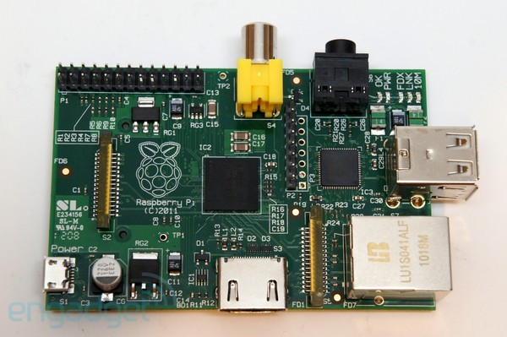
About the Raspberry Pi
$25 single-board computer about the size of a credit card
Launched March 2012 in the UK
Developed originally for educational purposes
1 Million sold in the first year

Slide 5
Hardware Specification
700Mhz ARM Processor
256/512MB RAM
HDMI Video Output
SD Storage
10/100 Ethernet Port
300mA/700mA power usage (1.5W/3.5W)
Weighs 45 grams
Notes:
Still has the ability to play 1080p Video

Slide 6
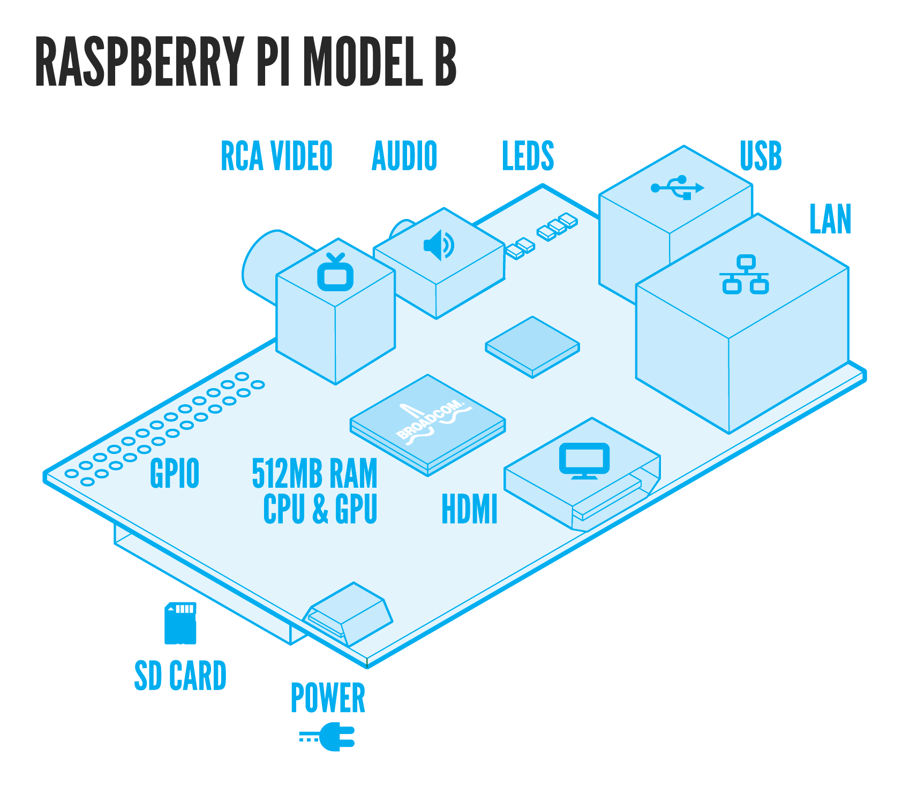
Notes:
Powered by cell phone charger

Slide 7


First Steps
Install and configure OS
Disable video
Connect to the internet
Notes:
-Raspbian Linux
-Headless because I did not have a screen, and more ram available.
-Internet connection sharing via windows

Slide 8
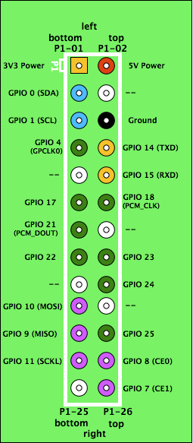
Interfacing with GPIO
26 Pin GPIO header
All GPIO pins are 3.3V, and are not 5V tolerant
Maximum current through all 3.3V pins is 50mA
Maximum Current per individual pin is 16mA
Notes:
-Go over the GPIO pins seperately
-If the 5v Pin is shorted to any other pin (besides gnd) it could brick the Pi

Slide 9
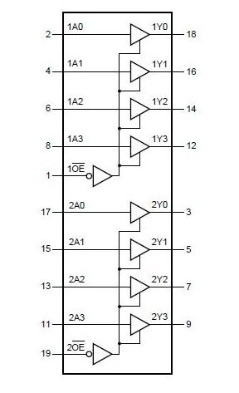
Protecting the Pi
74HC244
Zener diodes
Optical Isolation
IO expander chips (SPI or I2C)
Buffer IC
74HC244
Notes:
Protect the Pi from current and voltage
Go over the reasons I did not use them

Slide 10
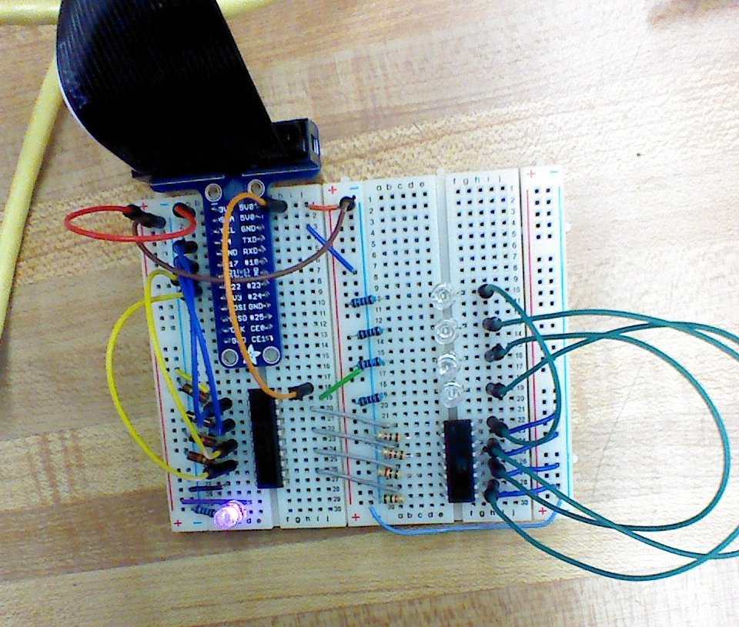
Early Tests
First test using the buffer IC and an optical isolator
Simple control of GPIO using Python
Notes:
-Limitation of 74HC244 to 6mA per pin.
-Also note the 74244 Being powered by the 5V pin converting the 5V
-3.15V is High for 74HC244, very close to 3.3V output

Slide 11
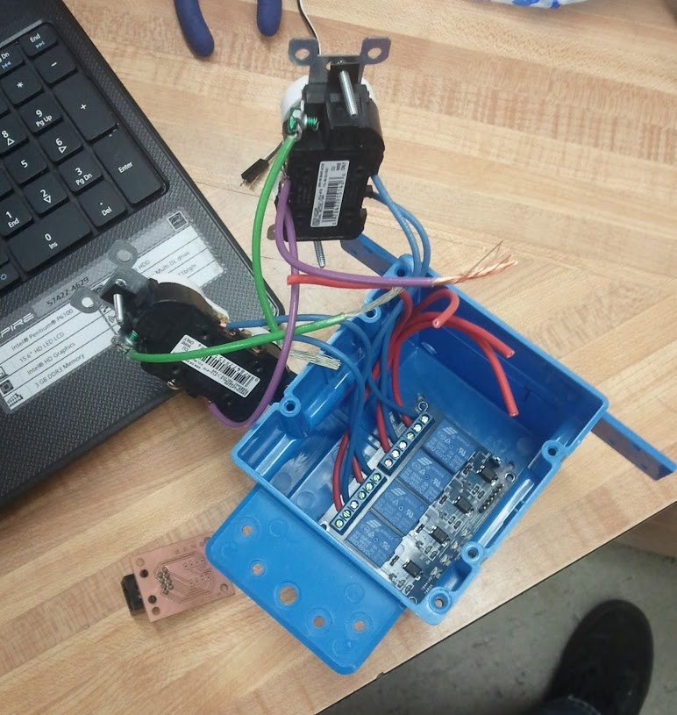
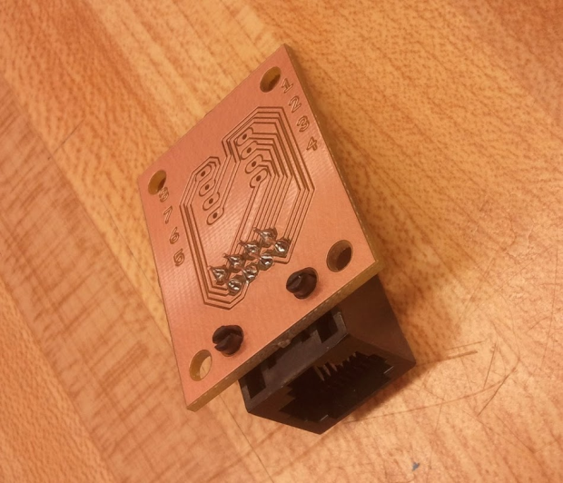
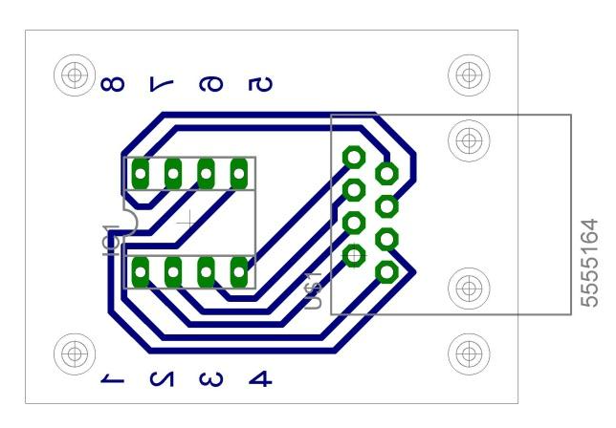
Relay Module Construction
Notes:
Talk about Ethernet Connection
-Had to make my own eagle library.

Slide 12
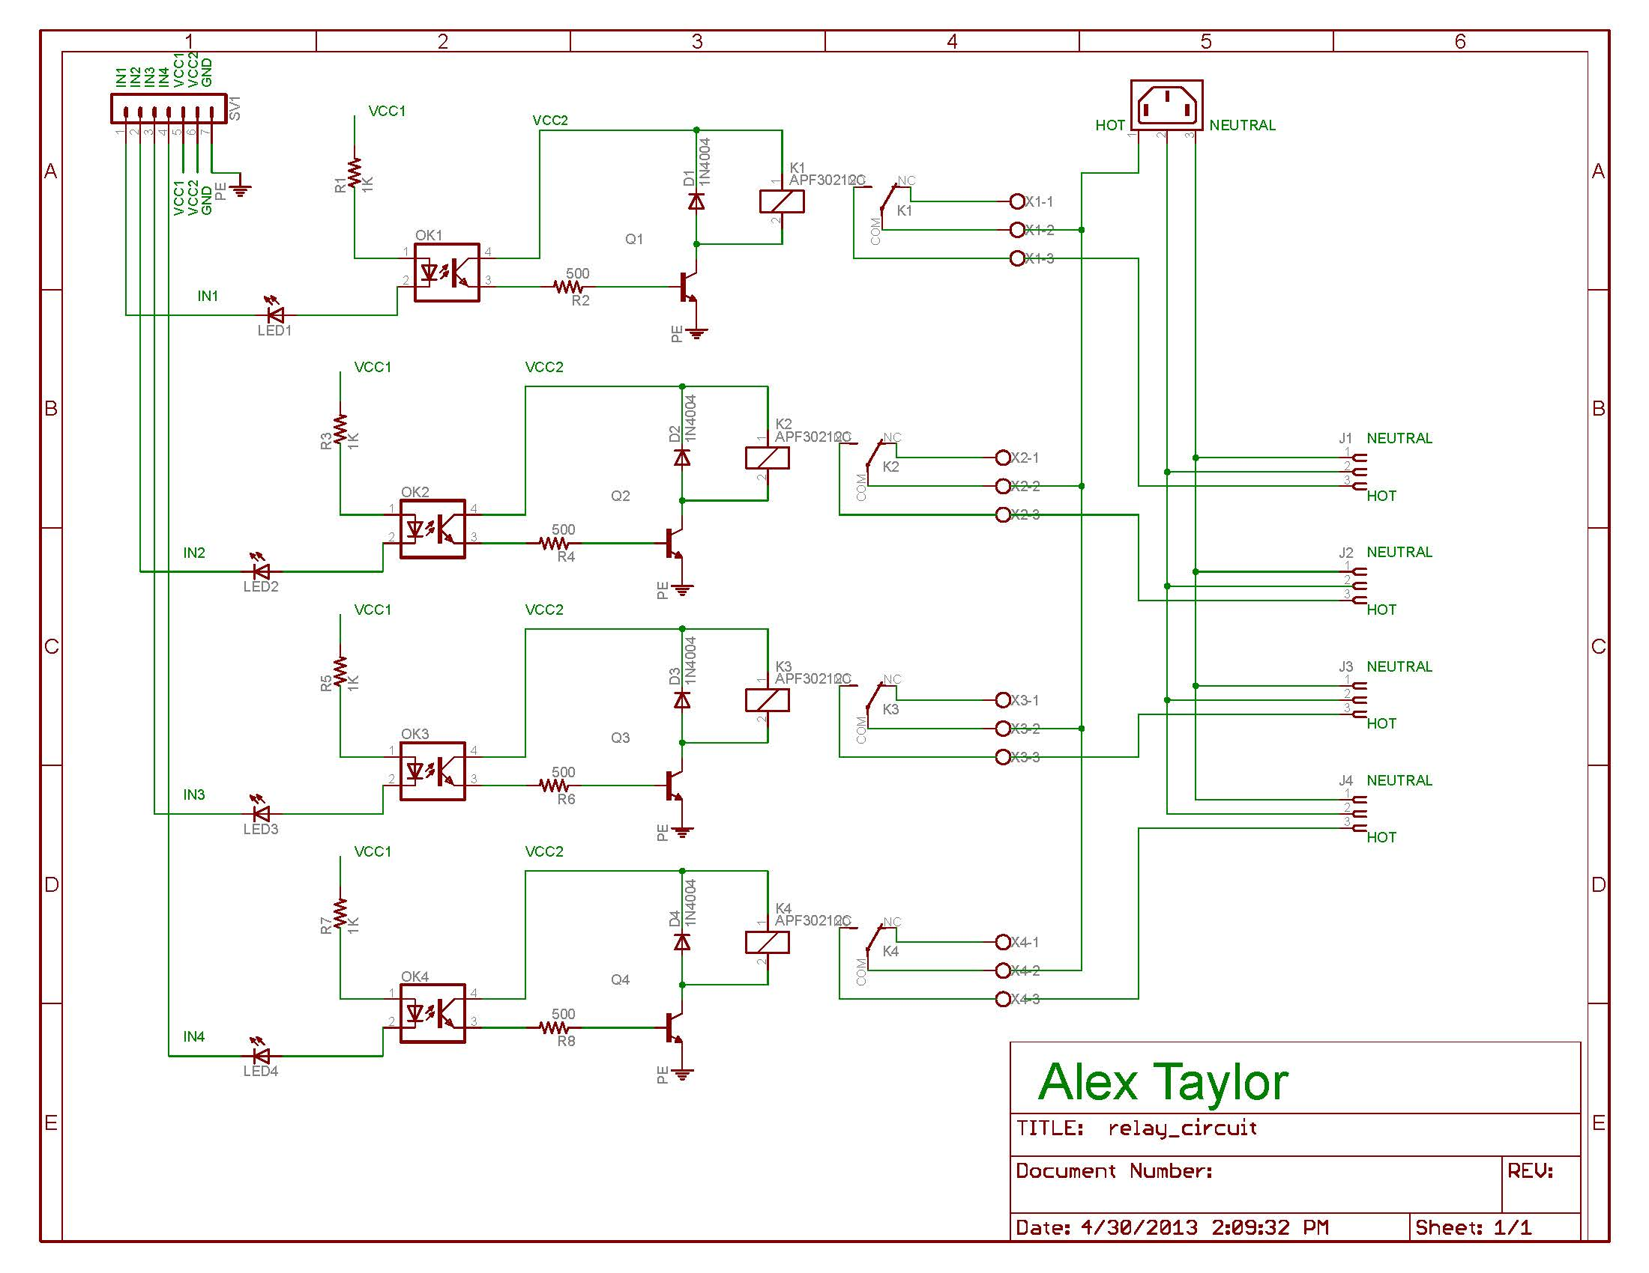
Relay Module Schematic
Notes:
Go over how it works

Slide 13
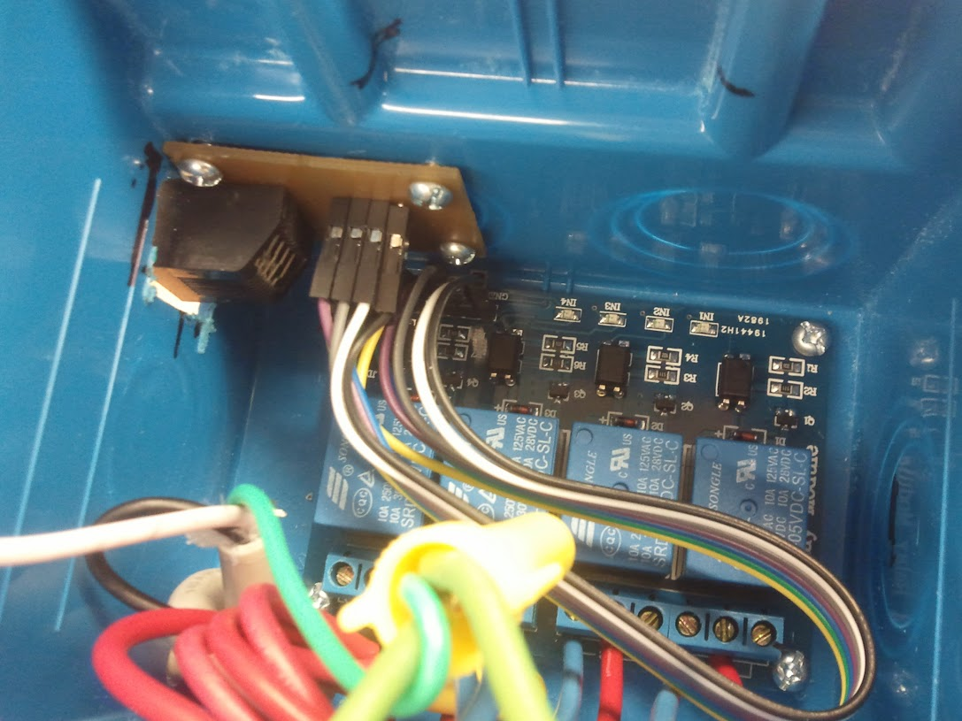
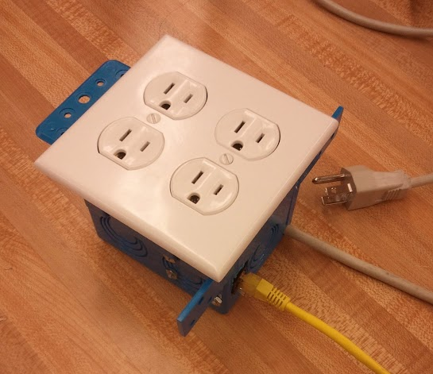
Continued

Slide 14
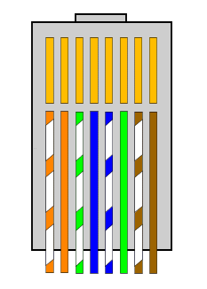
Ethernet Connection Interface
GND
INPUT1
INPUT2
INPUT3
INPUT4
VCC1
VCC2

Slide 15
Raspberry Pi Development Board
Purpose/Requirements
Protect Raspberry Pi pins
Provide Analog to Digital inputs
Provide PWM outputs
Include an RJ45 Connector to control relay Module
Allow option to power from external power source

Slide 16
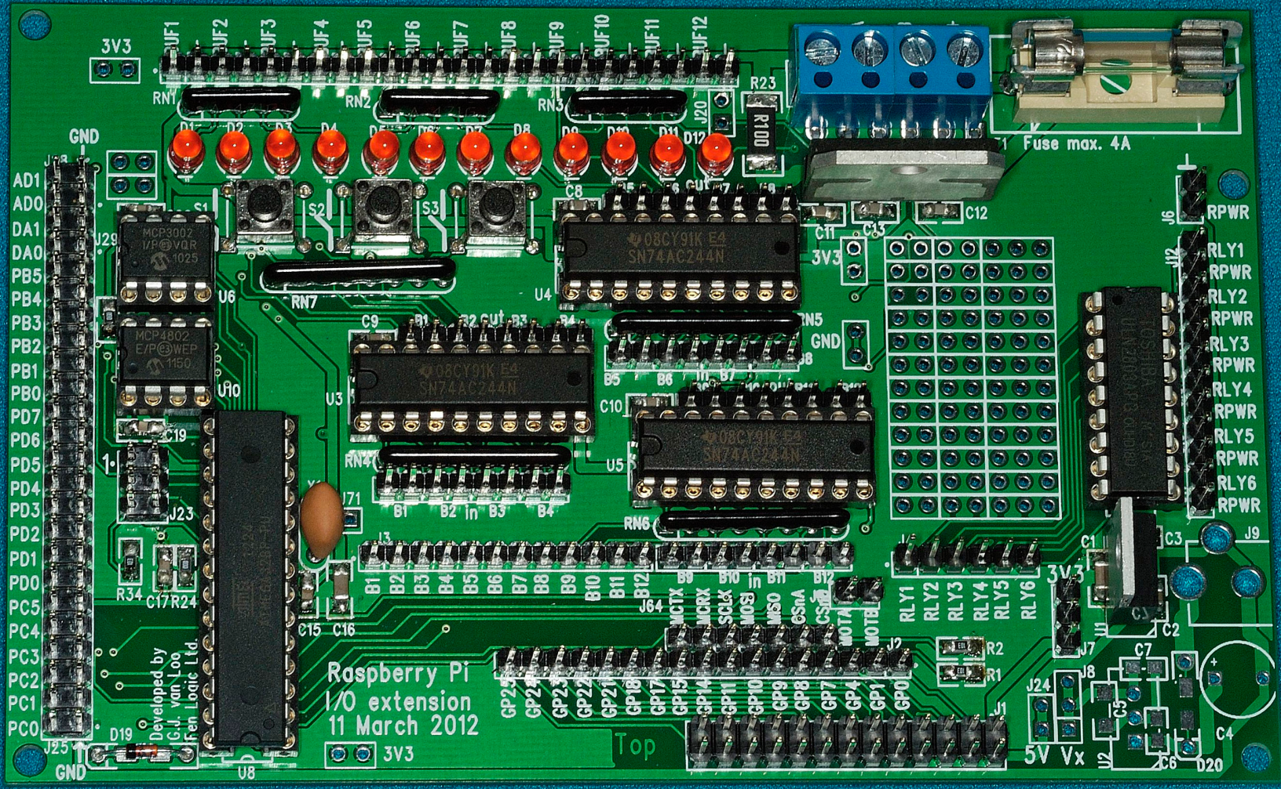
Currently Available Boards
The Gertboard – designed by Gert Van Loo: $30
Notes:
Talk about stats of the gertboard
-This thing is a BEAST
-Cost more than the Pi
-Still requires use of breadboard
-Learning curve very high, harder then raspberry pi
-So popular they limit the order quantity to 1

Slide 17
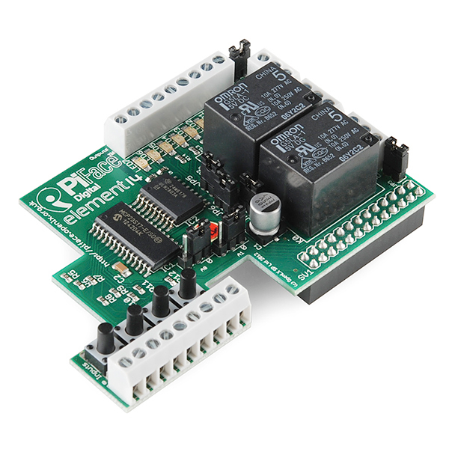
PiFace Expansion Board – Developed by the University of Manchester School of Computer Science: $20
Notes:
Talk about the profits available just from these development boards.
-Piface can only program in scratch or python.
-Uses an i2c expander chip for outputs – I have already gone over the reasons

Slide 18
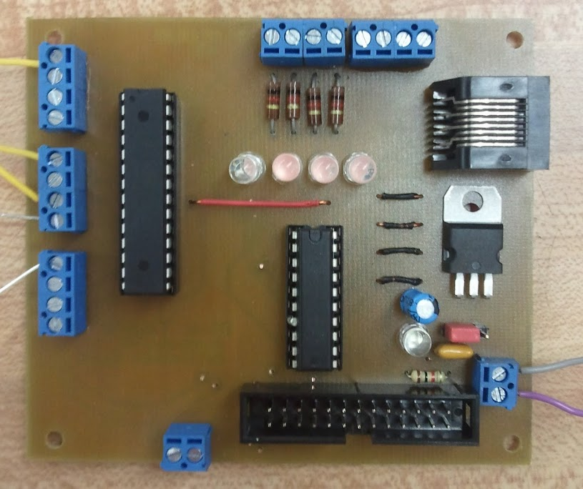
My Design

Slide 19
My Design
Digital Out
GND
3.3V
Analog Input/ Digital out
Microcontroller
Digital Out
3.3V
Buffer IC
Power Source Select
GND
Digital IO/ PWM
Alternate Supply (5V)
GPIO Header
GND
I2C Access

Slide 20
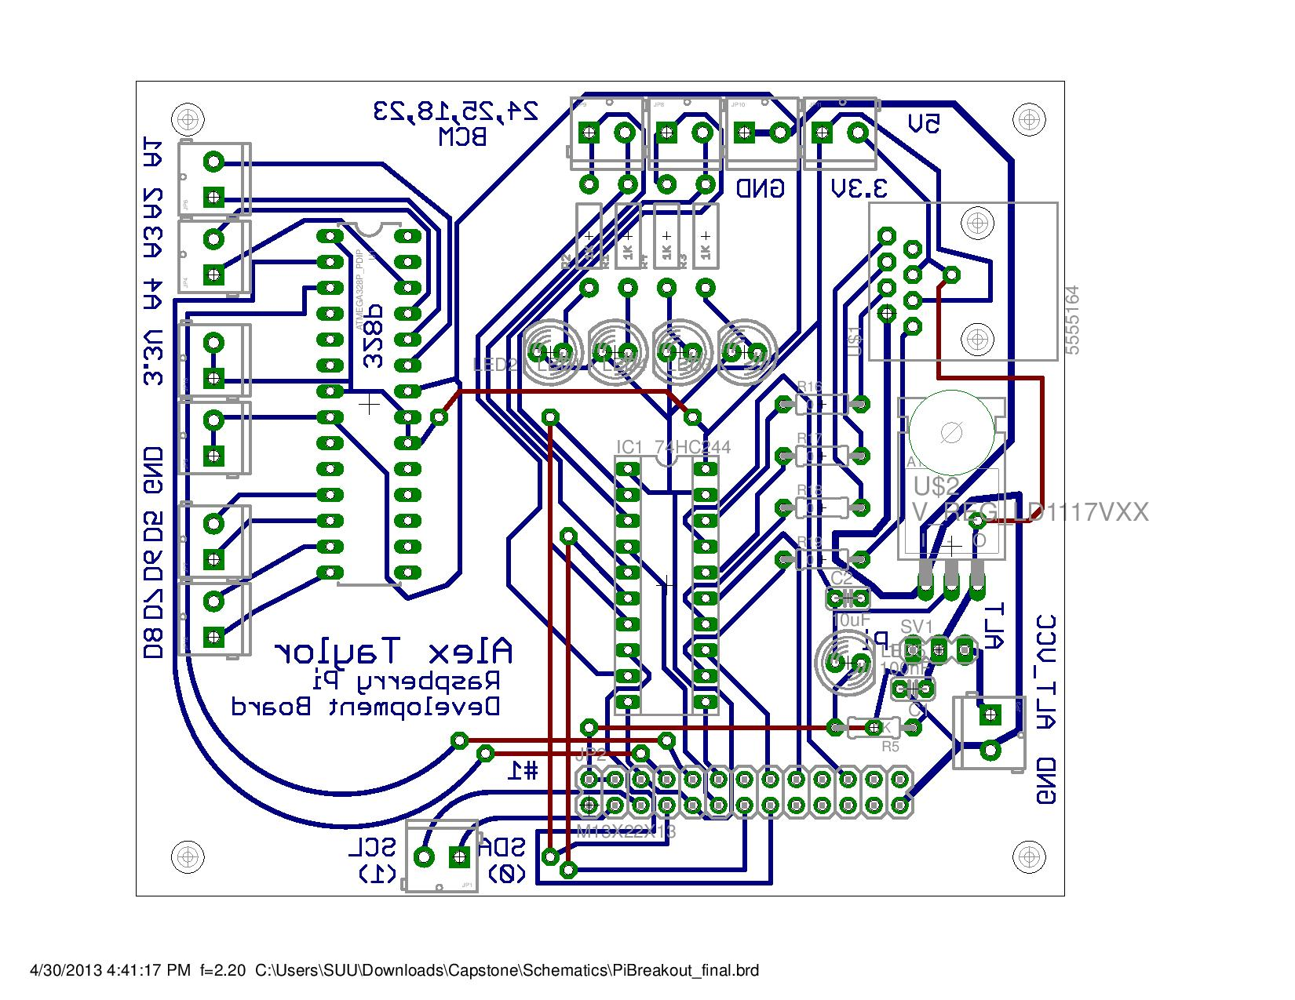
Board
Notes:
Board for anybody who is interested
-Note the artistic flair

Slide 21
Analog to Digital and PWM
Utilizes a Microcontrollers Analog channels and PWM outputs
Communication over UART Serial
Developed custom protocol to communicate with the Raspberry Pi
Able to configure pins as input and output
Analog input functionality
PWM outputs
All commands are send using only a single byte

Slide 22
Serial Communication
1010 1100
PWM
Flag
Pin 2
Pin 4
Program Flag
Set/Get
Flag
Pin 3
Pin 1
Analog/Digital Select
Notes:
Everything uses one byte except for pwm

Slide 23
Dev Board Python API
Layer of abstraction for ease of use
Functions Include
setRelay(num, state)
setOutput(num, state)
pinMode(AorD, direction)
digitalWrite(num, state)
digitalRead(num)
analogRead(num)
analogWrite(num, value)
Live Demo

Slide 24
Examples
Twitter Example
Program monitors twitter for any tweet containing #SUUEET
Gmail Example
Turns light on when a new message is present, off after its been read
SMS Example
????

Slide 25
Future Work
Facebook Support
C Support
Build Enclosure
Web interface

Slide 26
Thank You
Questions?

